Slide 1
Task 1
RESPONSIVE LANDING PAGE

Slide 2
<!DOCTYPE html>
<html lang="en">
<head>
<meta charset="UTF-8" />
<meta name="viewport" content="width=device-width, initial-scale=1" />
<title>Responsive Landing Page</title>
<style>
:root {
--primary-color: #5a67d8;
--secondary-color: #edf2f7;
--accent-color: #805ad5;
--text-color: #2d3748;
--bg-light: #f7fafc;
--font-family: 'Segoe UI', Tahoma, Geneva, Verdana, sans-serif;
}
* {
box-sizing: border-box;
}
body {
margin: 0;
font-family: var(--font-family);
color: var(--text-color);
background-color: var(--bg-light);
line-height: 1.6;
}
header {
background: linear-gradient(135deg, var(--primary-color), var(--accent-color));
color: white;
padding: 100px 20px 60px;
text-align: center;
}
header h1 {
font-size: 3rem;
margin: 0 0 20px;
}

Slide 3
header p {
font-size: 1.25rem;
margin-bottom: 30px;
max-width: 600px;
margin-left: auto;
margin-right: auto;
}
.btn-primary {
background-color: white;
color: var(--primary-color);
padding: 15px 40px;
border: none;
border-radius: 40px;
font-weight: 600;
font-size: 1rem;
cursor: pointer;
transition: background-color 0.3s ease, color 0.3s ease;
box-shadow: 0 8px 15px rgba(90,103,216,0.3);
}
.btn-primary:hover,
.btn-primary:focus {
background-color: var(--accent-color);
color: white;
outline: none;
}
main {
max-width: 1100px;
margin: 40px auto 80px;
padding: 0 20px;
}

Slide 4
.features {
display: grid;
grid-template-columns: repeat(auto-fit,minmax(250px,1fr));
gap: 40px;
}
.feature {
background-color: white;
border-radius: 12px;
padding: 30px 25px;
box-shadow: 0 4px 12px rgb(0 0 0 / 0.05);
text-align: center;
transition: transform 0.3s ease;
}
.feature:hover {
transform: translateY(-8px);
}
.feature h3 {
margin-bottom: 15px;
font-size: 1.5rem;
color: var(--primary-color);
}
.feature p {
font-size: 1rem;
color: #4a5568;
}
footer {
background-color: var(--primary-color);
color: white;
text-align: center;
padding: 25px 15px;
font-size: 0.9rem;
}

Slide 5
/* Responsive Typography */
@media (max-width: 600px) {
header h1 {
font-size: 2.2rem;
}
header p {
font-size: 1rem;
}
main {
margin: 20px auto 50px;
}
}
</style>
</head>
<body>
<header>
<h1>Lead Your Business Forward</h1>
<p>Innovative solutions to accelerate your digital transformation and unlock new opportunities.</p>
<button class="btn-primary" id="cta-button">Get Started</button>
</header>
<main>
<section class="features" aria-label="Key Features">
<article class="feature">
<h3>Easy Integration</h3>
<p>Seamlessly connect with your existing tools and platforms without any hassle or downtime.</p>
</article>
<article class="feature">
<h3>Reliable Performance</h3>
<p>Experience fast, secure, and scalable performance tailored to your business needs.</p>
</article>

Slide 6
<article class="feature">
<h3>Data-Driven Insights</h3>
<p>Leverage powerful analytics to make informed decisions and drive growth efficiently.</p>
</article>
<article class="feature">
<h3>24/7 Support</h3>
<p>We're here for you anytime with expert support and continuous improvements.</p>
</article>
</section>
</main>
<footer>
&copy; 2024 YourCompanyName. All rights reserved.
</footer>
<script>
// Add button click animation for fun
const ctaButton = document.getElementById('cta-button');
ctaButton.addEventListener('click', () => {
ctaButton.textContent = 'Redirecting...';
ctaButton.disabled = true;
// Simulate redirect after 1.5 seconds
setTimeout(() => {
ctaButton.textContent = 'Get Started';
ctaButton.disabled = false;
alert('Imagine redirecting to signup or contact page.');
}, 1500);
});
</script>
</body>
</html>

Slide 7
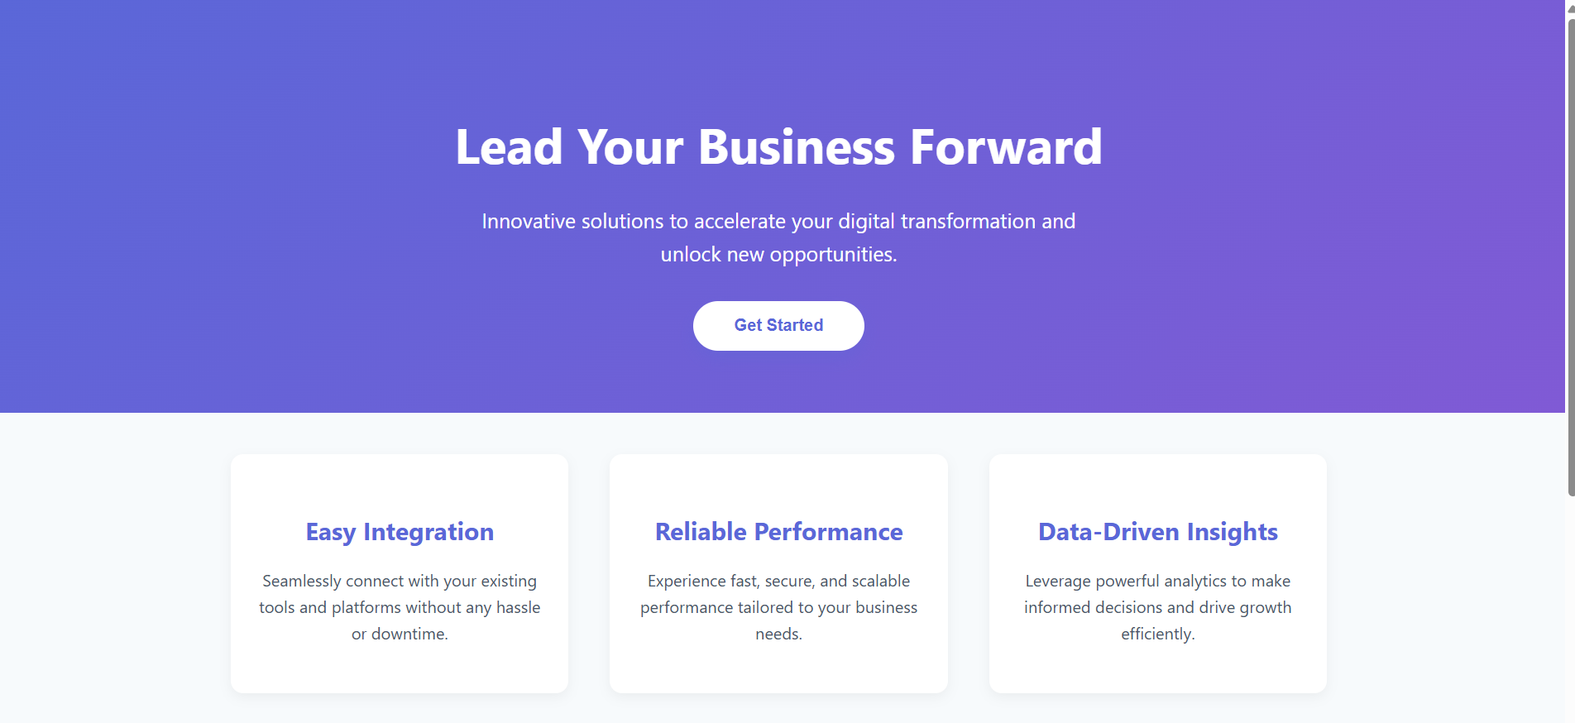

Slide 8
